Slide 1
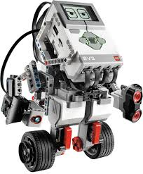
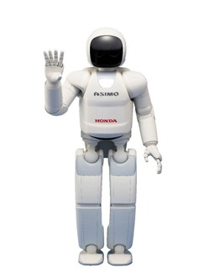
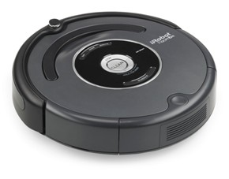
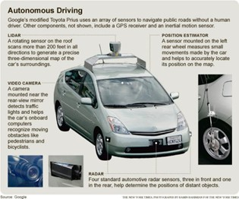
Lego Robotics!
What is a robot?
What are some of the robots you know?
A robot is a powered system that can perform specific tasks by itself without human help.

Slide 2
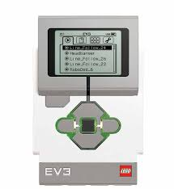
Your EV3 Robot Brick
Buttons
Back- Cancels action, Aborts running program, navigates to previous screens and shuts down.
Center- Turns the brick on, selects highlighted option
Up- Navigates up a list
Down- navigates down a list
Left- navigates left across the menu tabs
Right- Navigates right across the menu tabs
B
U
L
C
R
D

Slide 3
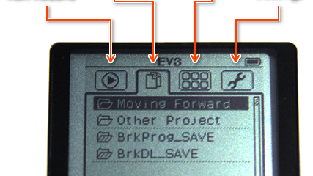
EV3 Menu tabs

Slide 4
Run Recent- Lists all programs Recently run
File Navigation-Lists all project folders & programs loaded onto EV3

Slide 5
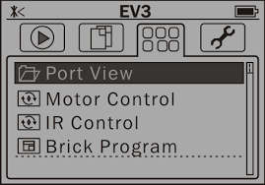
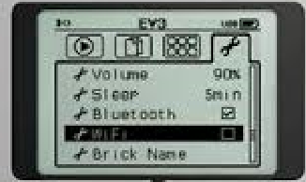
Your EV3 Robot Brick more menu tabs
Brick Applications-access to apps, port view, and other options
Settings-General configuration, volume, sleep, wireless settings.
Brick Applications-access to apps, port view, and other options
Brick applications
Settings

Slide 6
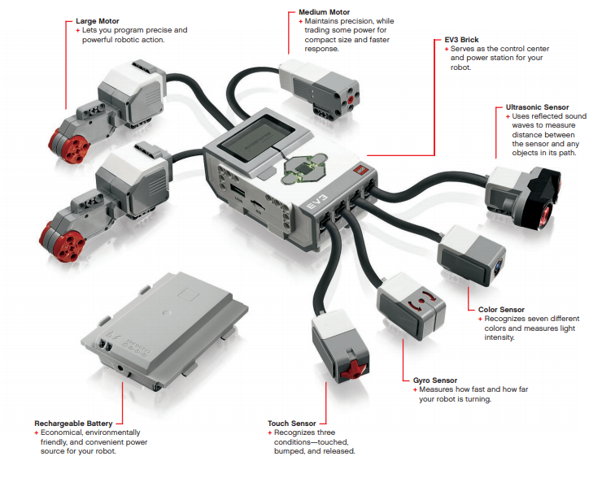

Slide 8
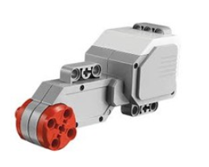
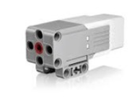
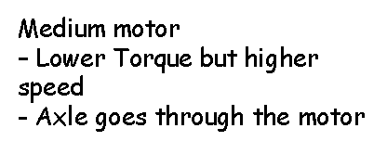
Motors- lettered ports are for motors.

Slide 9
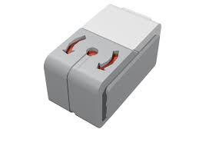
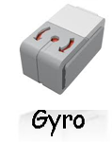
Sensors- numbered ports are for sensors.
Ultrasonic-The ultrasonic sensor measures distance to an object. It does this by sending out high frequency sound waves that bounce off any object in range and measuring how long it takes the sound to return to the sensor..
Touch- The touch sensor detects when it is being pressed or released. It can even be programmed to wait until it is both pressed and released.
Color-The color sensor can detect either the color or intensity of light.
The color sensor has three different modes: color, reflected light intensity, and ambient light intensity.
Gyro-The gyro sensor detects rotational motion in the plane indicated by the arrows on the top of the sensor housing. The sensor measures the rate of rotation in degrees per second and keeps track of the total angle of rotation in degrees.
Note: When connecting the gyro sensor to your EV3 brick, you should reset the angle and hold it still.

Slide 10
Programming
Toolbar
Programming canvas- lay out your program here.
Programming Blocks/tabs- find the building blocks to your program here.
Brick status/hardware- Manage communication with EV3 brick and see what motors and sensors are connected where. Also where you download programs to EV3 brick.
Toolbar- basic tools for working with your program.

Slide 11
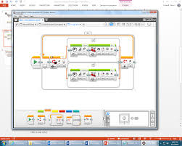
Programming your Robot: Your robot may not run your program the first time. You may have to try many times to get a working program.
Basic Programming WorkFlow Model
Create Program (initial instructions, connected programming blocks)
Test/Run Program
Is it working or NOT working?
Modify program.
Go back and make changes.

Slide 13
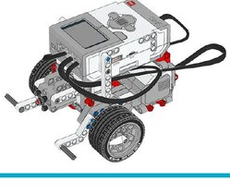
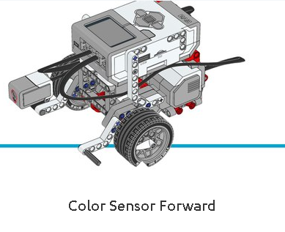
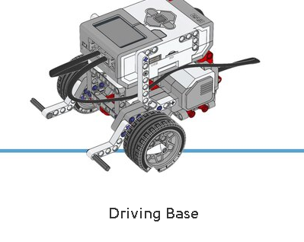
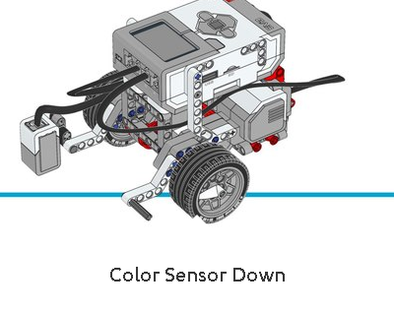
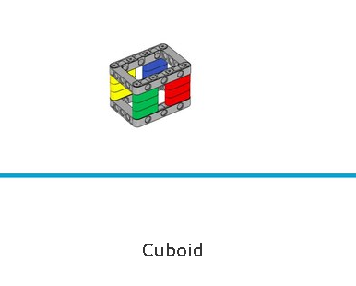
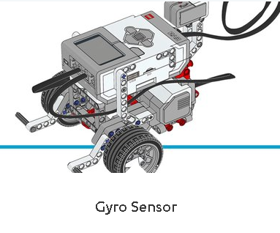
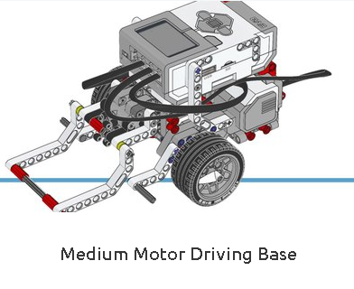
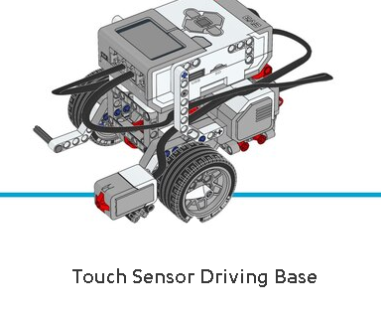
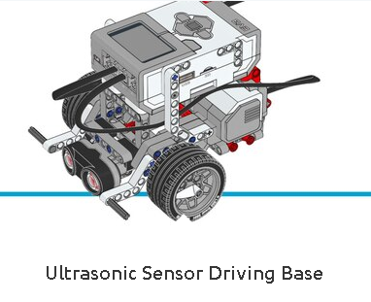
Let’s get Building!!!
Basic Robot Model
Click here!
Click on picture to build a robot or object

Slide 14
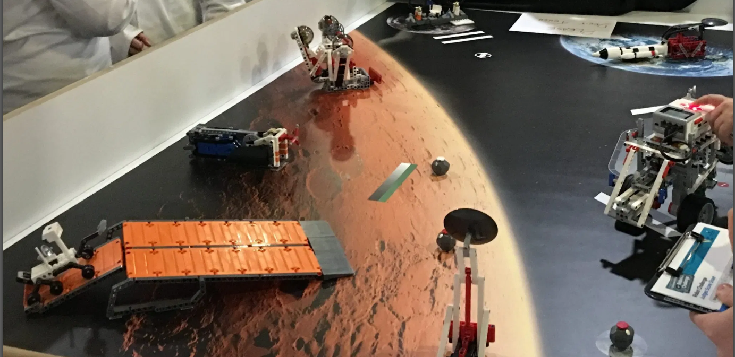
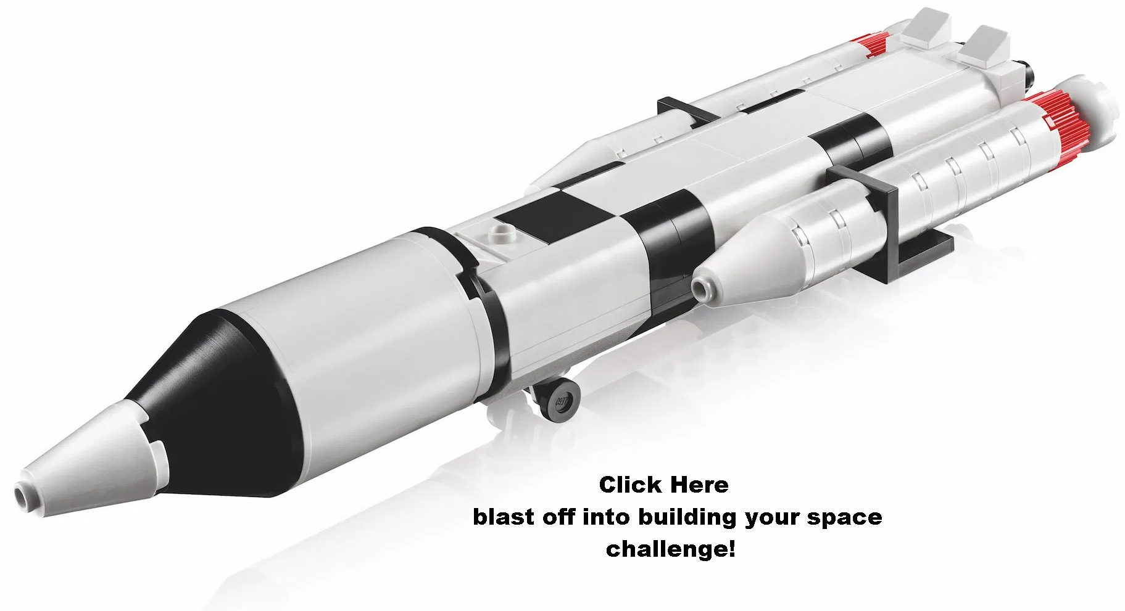
Space Challenge Set Models!!!

Slide 15
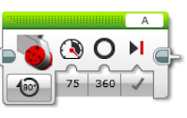
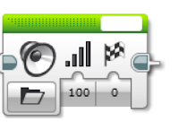
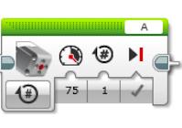
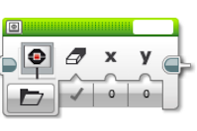
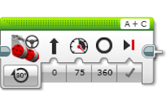
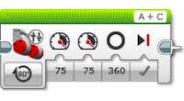
Action Blocks!
Large Motor: Block has capability to turn motor on, off, on for a set number of seconds, on for a set number of degrees, or on for set number of rotations.
Sound: Block has the capability to play a file, a tone, a note, or just make the sound stop altogether.
Display: This block displays information on the brick's screen. Information can be shown as text, shapes, images.
Medium Motor: smaller and lighter, so it can respond faster than large motor.
Move Steering: Block has the same functions as Large Motor, while operating two motors. The two motors will be synchronized unless the steering input is changed to move the robot right or left.
Move Tank: Block has the same functions as Large Motor, while operating two motors. Alternative power of the speeds result in the motors moving at different speeds. The default setting we use is degrees.

Slide 16
Flow Control!
Large Motor: Block has capability to turn motor on, off, on for a set number of seconds, on for a set number of degrees, or on for set number of rotations.
Sound: Block has the capability to play a file, a tone, a note, or just make the sound stop altogether.
Display: This block displays information on the brick's screen. Information can be shown as text, shapes, images.
Medium Motor: smaller and lighter, so it can respond faster than large motor.
Move Steering: Block has the same functions as Large Motor, while operating two motors. The two motors will be synchronized unless the steering input is changed to move the robot right or left.
Move Tank: Block has the same functions as Large Motor, while operating two motors. Alternative power of the speeds result in the motors moving at different speeds. The default setting we use is degrees.

Slide 17
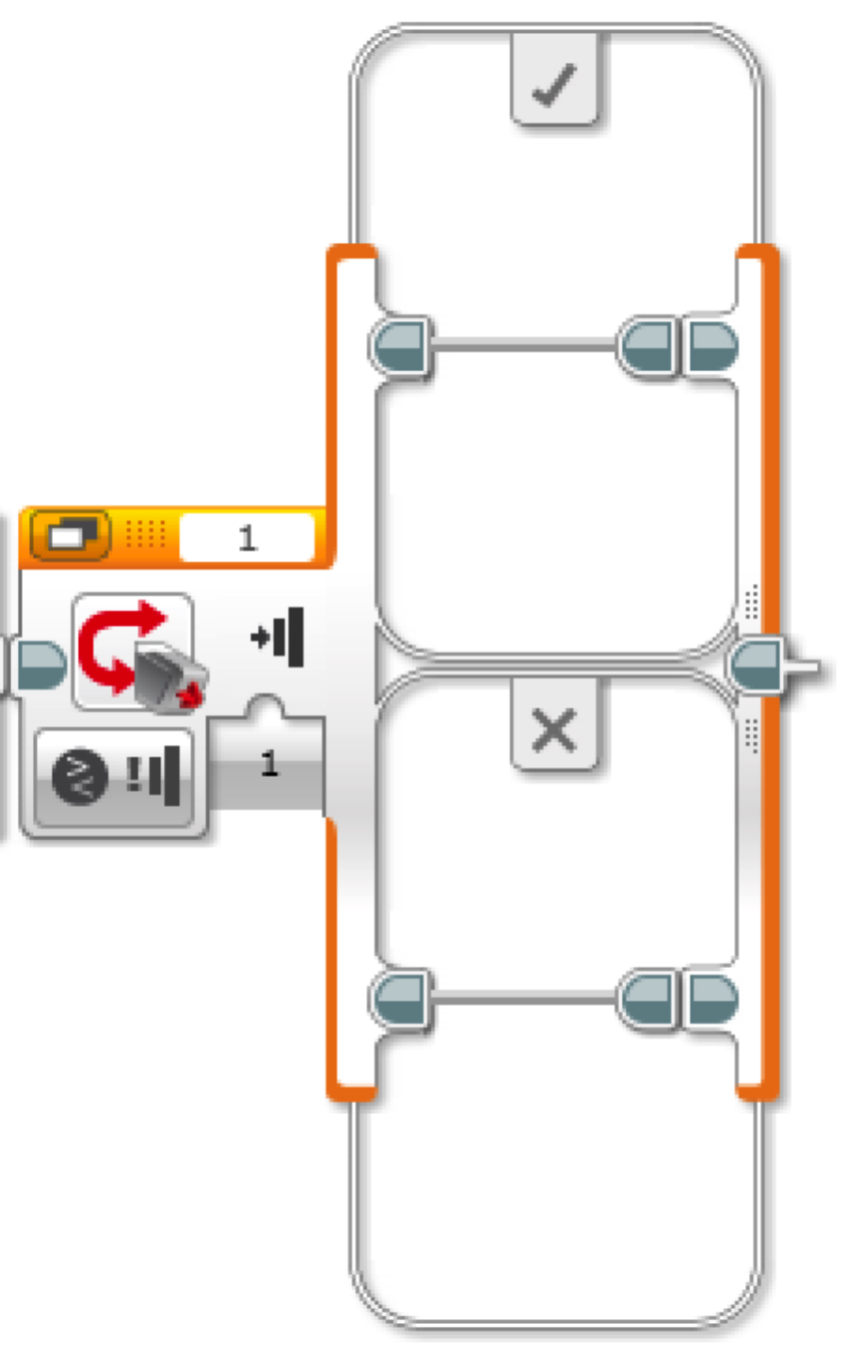
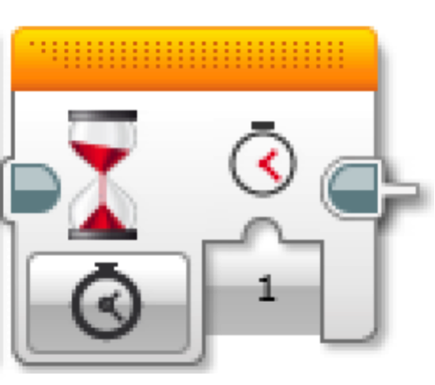
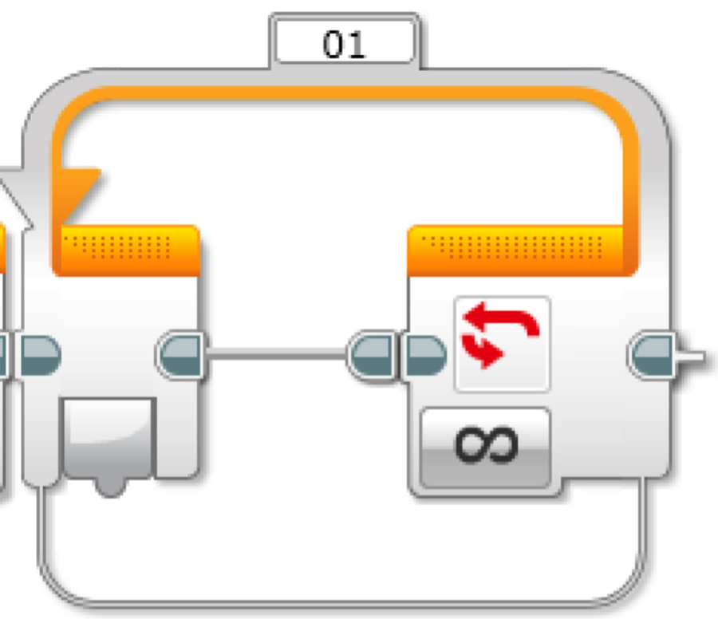
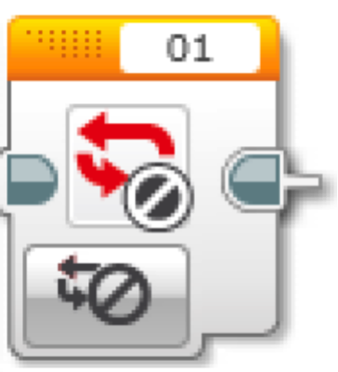
Flow Control!
Switch- The Switch block is a container that can contain two or more sequences of programming blocks. Each sequence is called a Case. A test at the beginning of the Switch determines which Case will run. Only one Case will run each time the Switch is executed.
The Start block- marks the beginning of a programming block sequence in your program. Your program can have more than one sequence. All sequences with a Start block will start automatically when a program is run, and the sequences will run at the same time.
Wait- This block makes your program wait for something before continuing to the next block in the sequence. The block may wait on time, sensor values, or a pressed brick button.
Loop Interrupt- The Loop Interrupt block makes a Loop block end. No more blocks in the loop sequence will execute, and the program will continue with any blocks that are after the loop.
Loop- This block works as a repeat. The code inside the loop will repeat until a certain condition is met. Conditions Include: Unlimited Once the condition is met, the robot may exit the loop.

Slide 18
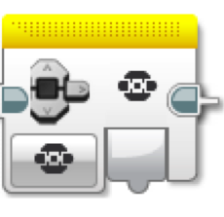
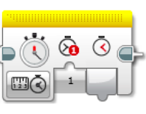
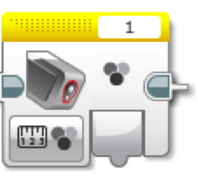
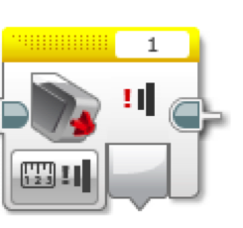
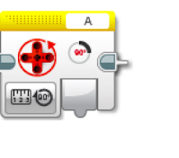
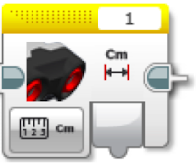
Sensor Blocks!
Brick Buttons-Block measures or compares the output of a variable when a button is pressed
Timer- Block measures, compares, or resets a timer in the program.
Color Sensor: The color sensor can detect either the color or intensity of light.
The color sensor has three different modes: color, reflected light intensity, and ambient light intensity.
Touch Sensor: Block must be used with touch sensor. This makes the brick react if the touch sensor is hit.
Ultrasonic Sensor: Block must be used with an ultrasonic sensor. This makes the brick aware of distances and what is around it.
Motor Sensor- Block measures, compares, or resets the motor rotation.

Slide 19
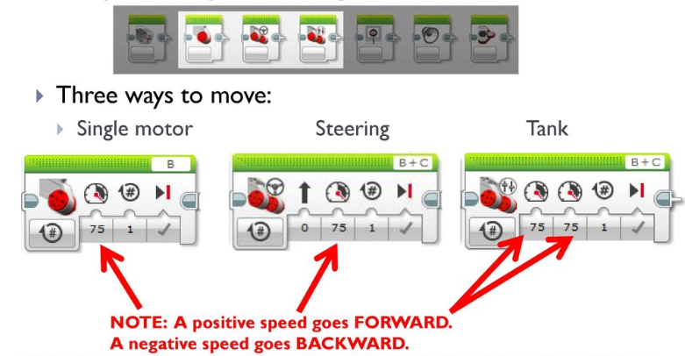
Let’s Make your Robot move!
Tank motor can move 2 wheels at the same time
Single motor can move only ONE wheel at a time

Slide 28
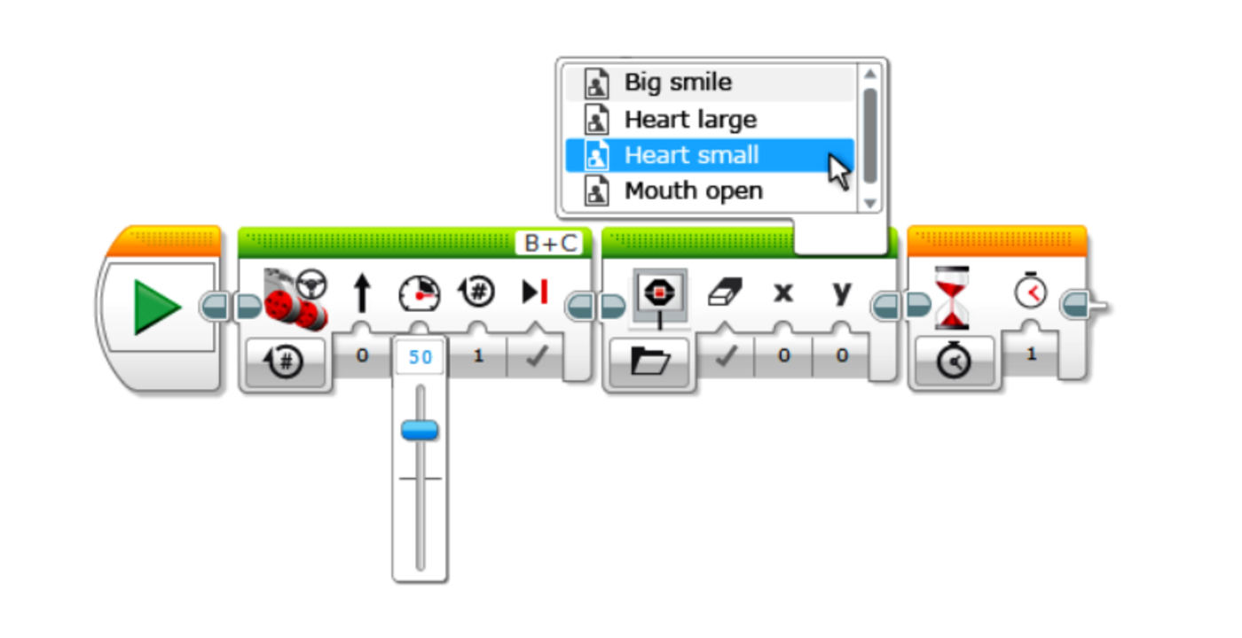
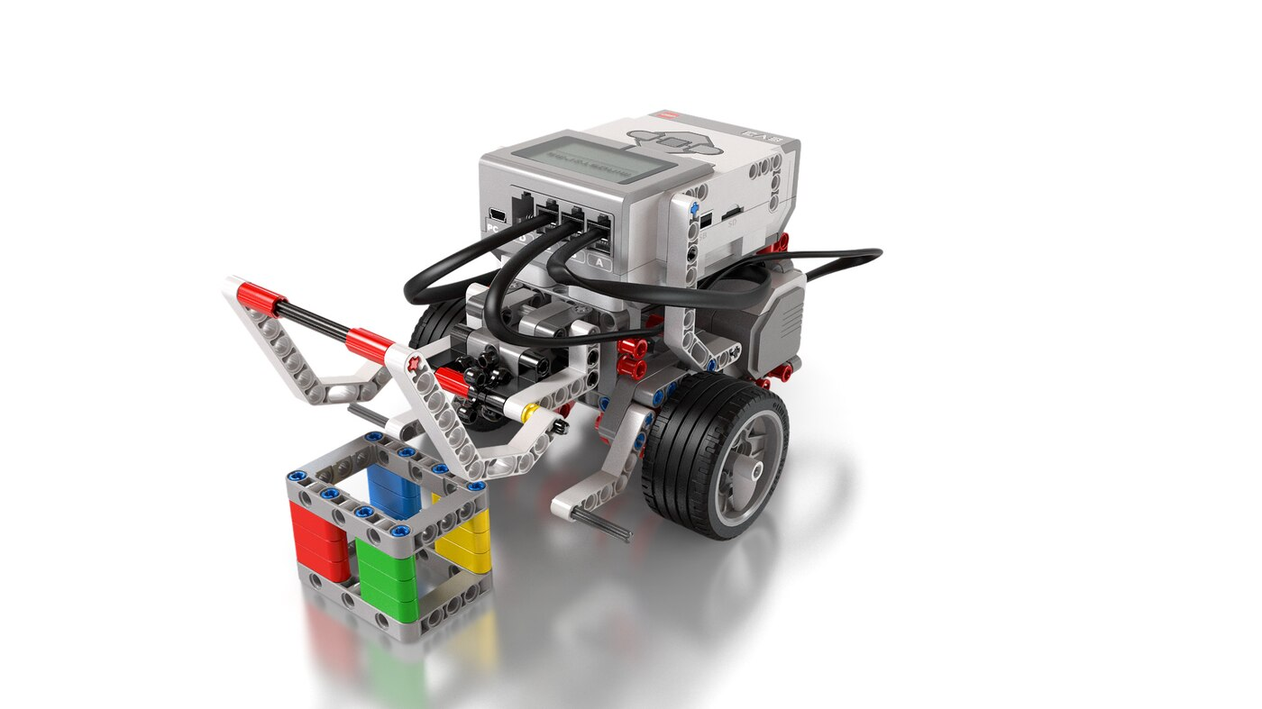
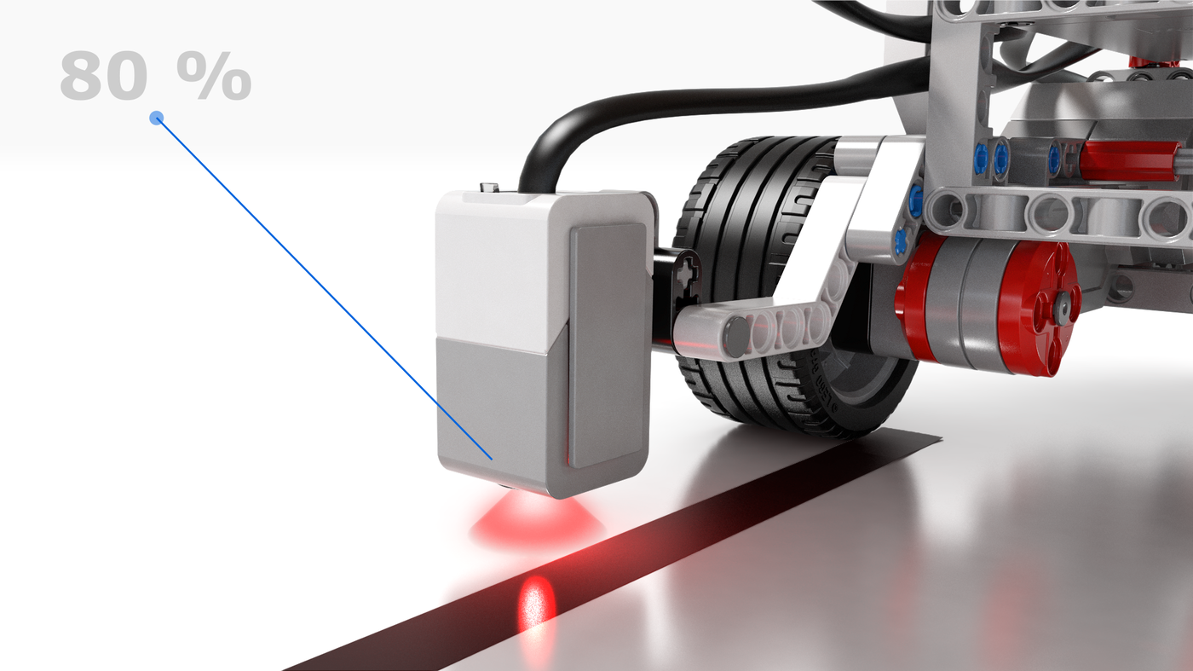
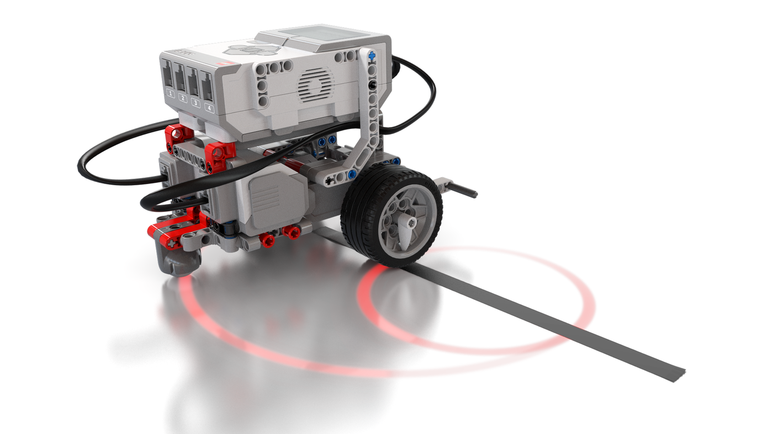
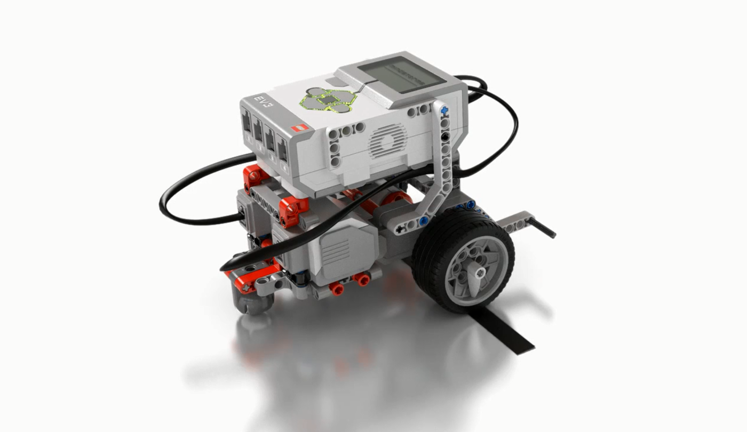
Now that you have your robot let’s program!
Click on lessons below to see how to program!
Basics Configuration
Move objects
Switch
Curved move
Straight move

